Slide 1
React Lunch & Learn

Slide 2
Agenda
Intro to React
Why React?
How to get started
Demo
Resources Available

Slide 3
What is React?
A JavaScript library for building user interfaces
Created by Facebook, in 2013
Single Page and Mobile applications
Component Based

Slide 4
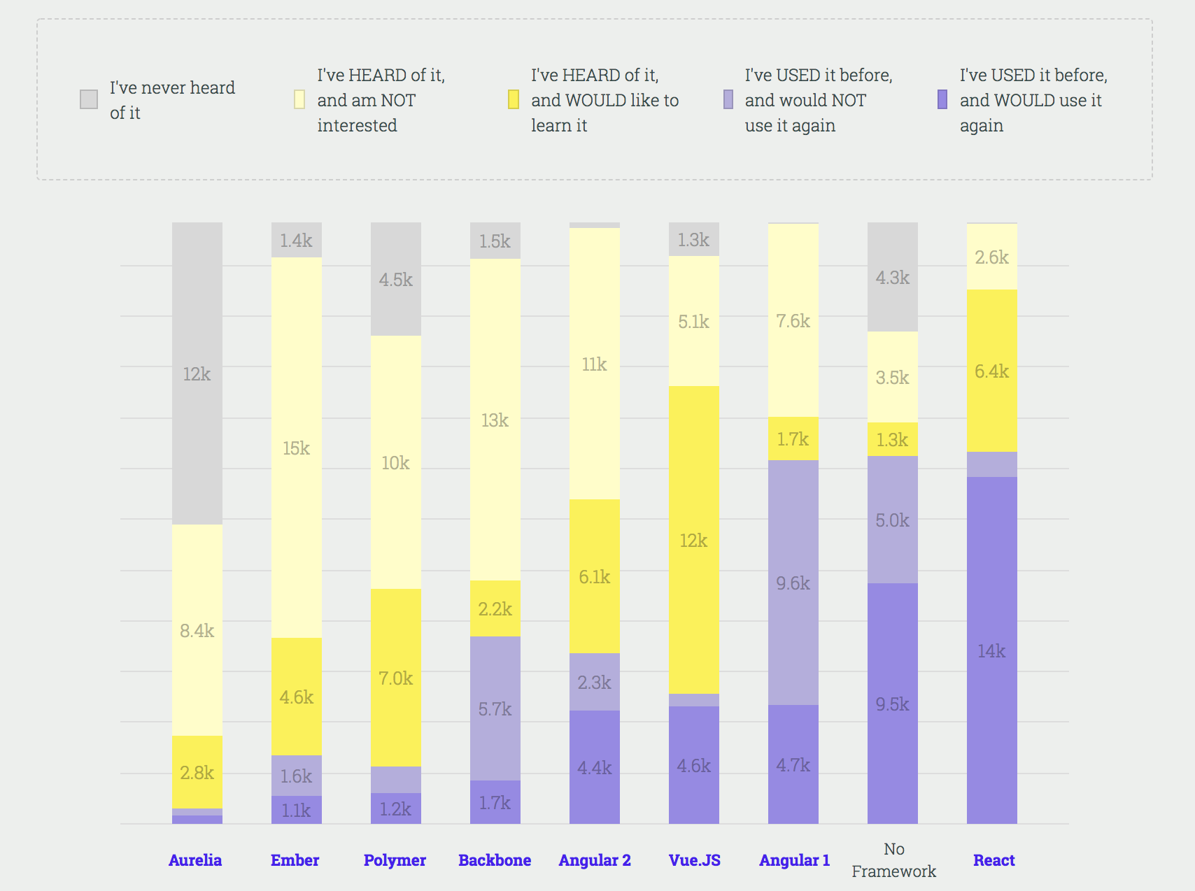
Why React?
React aims primarily to provide speed, simplicity, and scalability.
https://medium.freecodecamp.org/i-just-asked-23-000-developers-what-they-think-of-javascript-heres-what-i-learned-9a06b61998fa

Slide 5
How to get started
Install React Dev Tools
Have Node and NPM installed (Can use brew)
npm install –g create-react-app
create-react-app NAME
cd NAME
npm start

Slide 6
DEMO
PowerPoint and Commented code will be available after the demo.

Slide 7
Current State Flow
App
MovieList
MovieForm
Movie

Slide 8
Ideal State Flow
App
MovieList
MovieForm
Movie

Slide 9
Current State Flow
App
MovieList
MovieForm
Movie
https://redux.js.org
https://medium.com/@dan_abramov/you-might-not-need-redux-be46360cf367 Link 3

Slide 10
Resources
"Thinking in React" https://reactjs.org/docs/thinking-in-react.html
State and Lifecycle: https://reactjs.org/docs/state-and-lifecycle.html
Rendering an Element into the DOM https://reactjs.org/docs/rendering-elements.html
Lists and Keys https://reactjs.org/docs/lists-and-keys.html
Typechecking With PropTypes https://reactjs.org/docs/typechecking-with-proptypes.html
Forms: https://reactjs.org/docs/forms.html
Components and Props https://reactjs.org/docs/components-and-props.html
Conditional Rendering https://reactjs.org/docs/conditional-rendering.html

